Slide 1
Dynamics in Two-Sided Attention Markets
— An Optimization Perspective
Haiqing Zhu
Panel: Prof. Lexing Xie, Dr. Yun Kuen Cheung, Dr. Thang Bui
Start Date: August, 2023

Slide 2


Model - Two-sided Attention Market
Items (Visibilities, Qualities)

Slide 3

Model - Two-sided Attention Market
Items (Visibilities, Qualities)
Consumptions

Slide 4

Model - Two-sided Attention Market
Items (Visibilities, Qualities)
Items (Qualities)
Consumptions
Rewards

Slide 5
Model - Two-sided Attention Market
Items (Visibilities, Qualities)
Items (Qualities)
Consumptions
Rewards

Slide 6
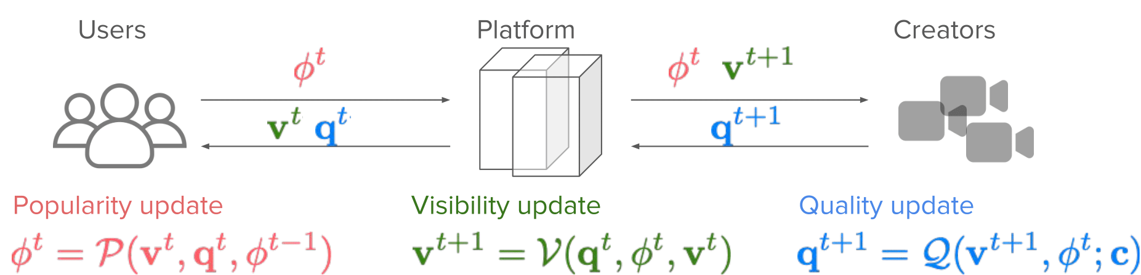
Model: Mathematical Abstraction
Popularity
Visibility
Quality

Slide 7
Results: Behaviour of Attention Dynamics
Equivalence to Optimisation Dynamics: It is proven that, the two sided market dynamics (under various recommendation policies) are equivalent to mirror descent w.r.t. some potential functions (not necessarily convex)

Slide 8
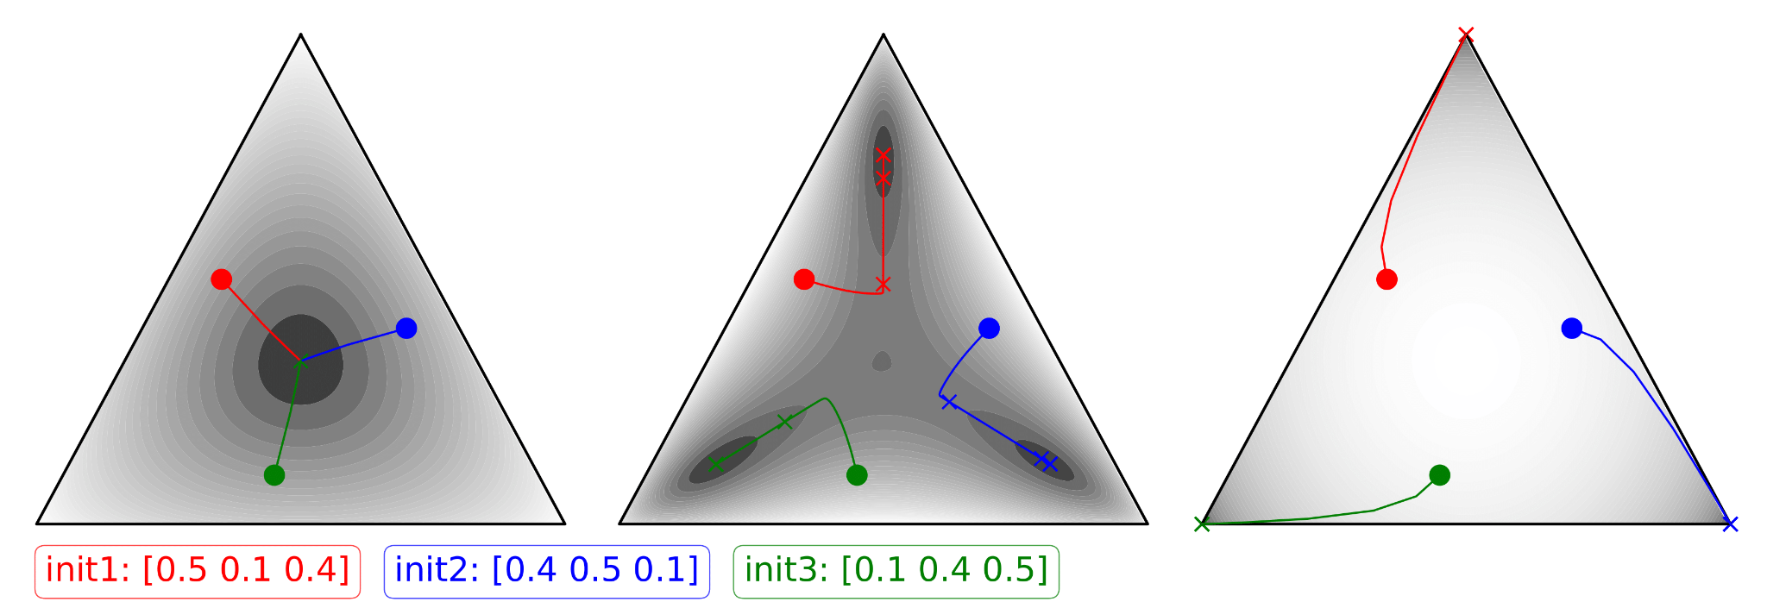
Results: Behaviour of Attention Dynamics
Equivalence to Optimisation Dynamics: It is proven that, the two sided market dynamics (under various recommendation policies) are equivalent to mirror descent w.r.t. some potential functions (not necessarily convex)
Convergence Behaviours:

Slide 9
Progress/Plan:
Project 2: Entry Barrier (Rejected by AAAI’25, plan to resubmit: Neurips’25)
Project 3: Two-sided Market
Submitted to EC’25
Project 4: Anticipating agents in machine learning. Plan to submit: Neurips’25
Project 1: Betting Market (Published in ICML’24)
2023.8
Start
2024.9 - 2025.1
Internship at MPI Tuebingen
Potential projects:
1. Multi-dimentional Betting Markets
2. Explore - Exploit dynamics in Attention Markets
3. Dynamics in Academic Markets

